Slide 1
CSE 3002- programming in java unit II inheritance
Dr. R. Manikandan
Assistant professor (senior grade)
Vit bhopal university

Slide 2
Inheritance: Introduction
Inheritance is an important pillar of OOP(Object Oriented Programming). It is the mechanism in java by which one class is allow to inherit the features(fields and methods) of another class.
For example, a child inherits the traits (a distinguishing quality or characteristic ) of his/her parents.
Inheritance represents the IS-A relationship which is also known as a parent-child relationship.
Terms used in Inheritance
Class: A class is a group of objects which have common properties. It is a template or blueprint from which objects are created.
Sub Class/Child Class: Subclass is a class which inherits the other class. It is also called a derived class, extended class, or child class.
Super Class/Parent Class: Super class is the class from where a subclass inherits the features. It is also called a base class or a parent class.
Reusability: As the name specifies, reusability is a mechanism which facilitates you to reuse the fields and methods of the existing class when you create a new class. You can use the same fields and methods already defined in the previous class.

Slide 3
Inheritance: Why?
Common Behaviors
Shirt | Trousers
getId() getPrice() getSize() getColor() getFit() | getId() getPrice() getSize() getColor() getFit() getGender()
setId() setPrice() setSize() setColor() setFit() | setId() setPrice() setSize() setColor() setFit() setGender()
display() | display()
Notes:
The table in the slide shows a set of behaviors for some classes belonging to the Duke’s Choice shopping cart application, the Shirt class and the Trousers class. The classes are shown fully encapsulated so that all field values are accessible only through setter and getter methods. Notice how both classes use many of the same methods; this may result in code duplication, making maintenance and further expansion more difficult and error-prone.

Slide 4



Code Duplication
Inheritance: Why?
Shirt
Trousers
Socks
getId()
display()
getPrice()
getSize()
getColor()
getFit()
getId()
display()
getPrice()
getSize()
getColor()
getFit()
getGender()
getId()
display()
getPrice()
getSize()
getColor()
Notes:
If Duke's Choice decides to add a third item, socks, as well as trousers and shirts, you may find even greater code duplication. The diagram in the slide shows only the getter methods for accessing the properties of the new objects.

Slide 5

Inheritance: Why?
Clothing
Benefits:
There is less code duplication.
Code modification can be done once for all subclasses.
display()
getSize()
getColor()
getId()
getPrice()
Shirt
Trousers
Socks
getFit()
getFit()
getGender()
Notes:
You can eliminate code duplication in the classes by implementing inheritance. Inheritance enables programmers to put common members (fields and methods) in one class (the superclass) and have other classes (the subclasses) inherit these common members from this new class.
An object instantiated from a subclass behaves as if the fields and methods of the subclass were in the object. For example,
The Clothing class can be instantiated and have the getId method called, even though the Clothing class does not contain getId. It is inherited from the Item class.
The Trousers class can be instantiated and have the display method called even though the Trousers class does not contain a display method; it is inherited from the Clothing class.
The Shirt class can be instantiated and have the getPrice method called, even though the Shirt class does not contain a getPrice method; it is inherited from the Clothing class.

Slide 6
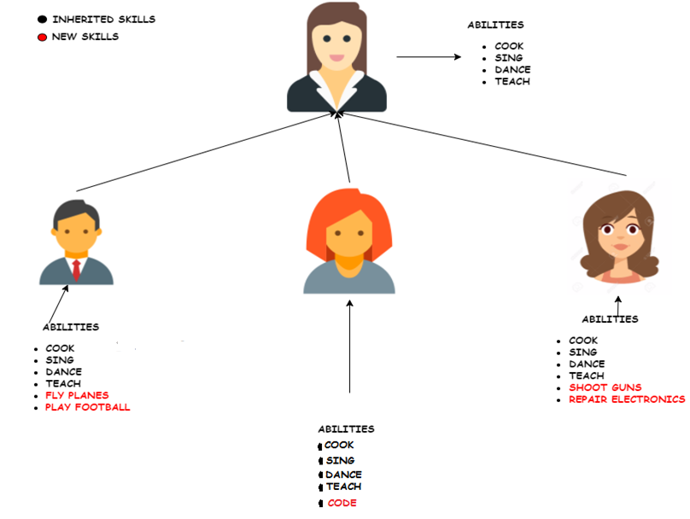
Inheritance: Introduction

Slide 7
Inheritance: Introduction
Syntax
class Subclass-name extends Superclass-name
{
//methods and fields
}
The extends keyword indicates that you are making a new class that derives from an existing class. The meaning of "extends" is to increase the functionality.
subclass
superclass
public class Shirt extends Clothing {
private int neckSize;
public int getNeckSize(){
return neckSize;
}
public void setNeckSize(int nSize){
this.neckSize = nSize;
}
}

Slide 8
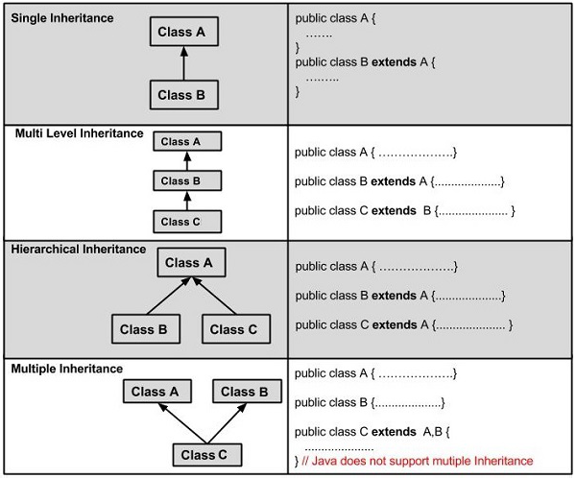
Types of Inheritance
On the basis of class, there can be three types of inheritance in java: single, multilevel and hierarchical.
In java programming, multiple and hybrid inheritance is supported through interface only.
Example:
SingleInheritance.java
MultilevelInheritance.java
HierarchicalInheritance.java

Slide 9
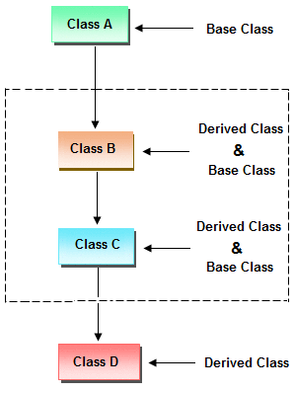
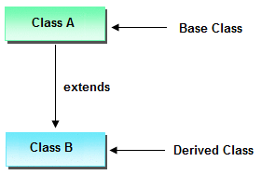
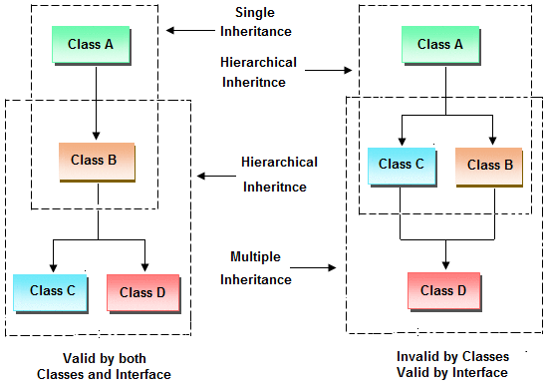
Types of Inheritance
Single Inheritance
Multiple Inheritance
Hybrid Inheritance

Slide 10
Types of Inheritance
Why multiple inheritance is not supported in java?
To reduce the complexity and simplify the language, multiple inheritance is not supported in java.
Consider a scenario where A, B, and C are three classes. The C class inherits A and B classes. If A and B classes have the same method and you call it from child class object, there will be ambiguity to call the method of A or B class.
Since compile-time errors are better than runtime errors, Java renders compile-time error if you inherit 2 classes. So whether you have same method or different, there will be compile time error.
Example: C.java

Slide 11
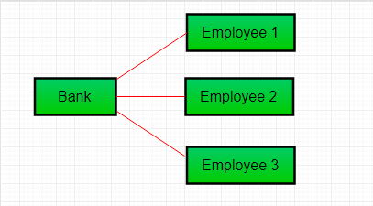
Association Vs Composition Vs Aggregation
Association
Association refers to the relationship between multiple objects. It refers to how objects are related to each other and how they are using each other's functionality.
Composition and aggregation are two types of association.
Association can be one-to-one, one-to-many, many-to-one, many-to-many.
Example:
Two separate classes Bank and Employee are associated through their Objects. Bank can have many employees, So it is a one-to-many relationship.

Slide 12
Association Vs Composition Vs Aggregation
Composition (Part of)
The composition is the strong type of association. An association is said to composition if an Object owns another object and another object cannot exist without the owner object.
In composition, both the entities are dependent on each other.
Consider the case of Human having a heart. Here Human object contains the heart and heart cannot exist without Human.
Aggregation (Has-A)
Aggregation is a weak association. An association is said to be aggregation if both Objects can exist independently.
It is a unidirectional association i.e. a one way relationship. For example, department can have no of students but vice versa is not possible and thus unidirectional in nature.
In Aggregation, both the entries can survive individually which means ending one entity will not effect the other entity
For example, a Team object and a Player object. The team contains multiple players but a player can exist without a team.

Slide 13
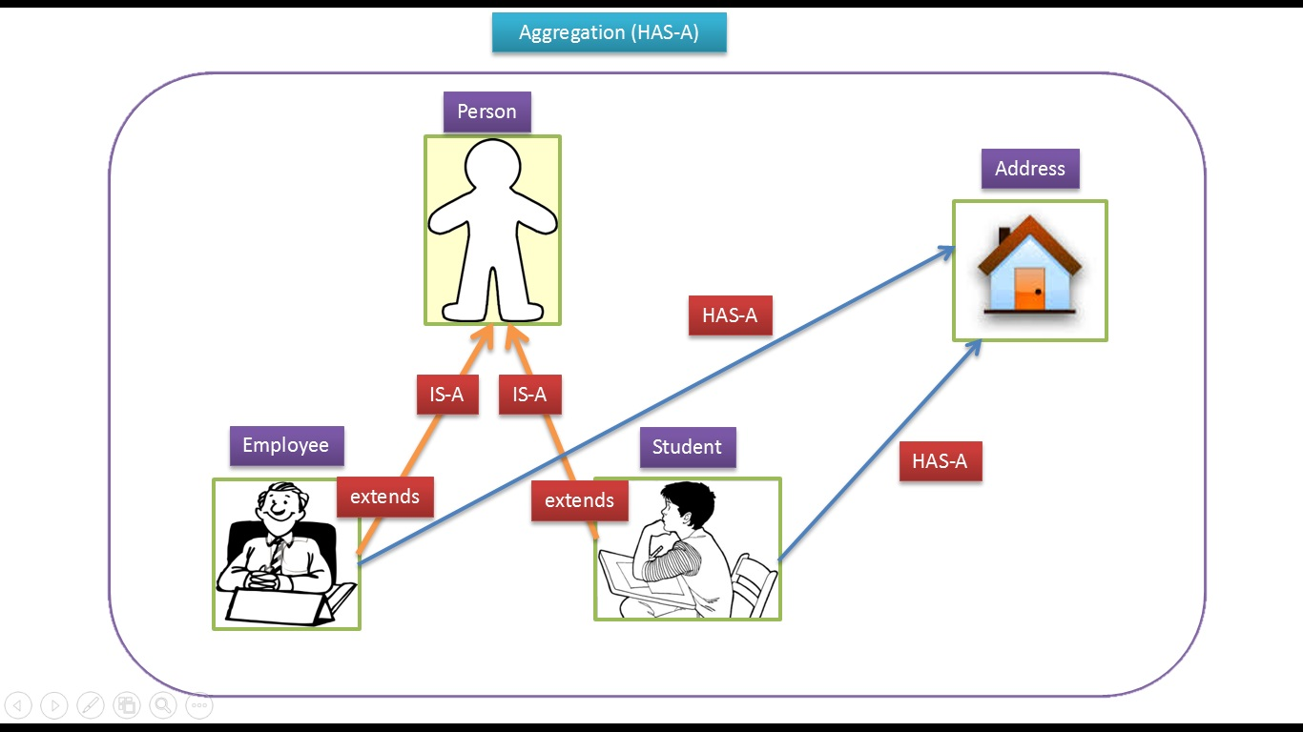
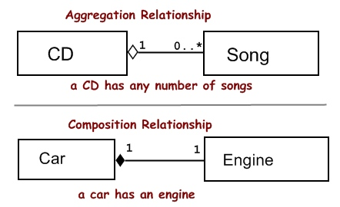
Is-A Vs Has-A Vs Part-of Relationship
Example:
RelationsDemo.java

Slide 14
Super Keyword
The super keyword is similar to this keyword. Following are the scenarios where the super keyword is used.
It is used to differentiate the members of superclass from the members of subclass, if they have same names.
It is used to invoke the superclass constructor from subclass.
Super keyword can be used at variable, method and constructor level.
Example:
Super_Variable.java
Super_Method.java
Super_Constructor.java

Slide 15
Why super cannot be used in static context?
Static keyword belongs to the class rather than the instance of the class. Whenever a method is declared as static, it can only be accessed by its Class name.
Static method can only have access to its static data members and methods.
It cannot access non - static members i.e. instance variables.

Slide 16
Inheritance and Constructors
Constructor of base class with no argument gets automatically called in derived class constructor.
But, if we want to call parameterized constructor of base class, then we can call it using super().
Base class constructor call must be the first line in derived class constructor.
Example:
Constructor_Inheritance1.java
Constructor_Inheritance2.java
Constructor_Inheritance3.java

Slide 17
Inheritance and Constructors
Can constructor inherited in Java?
No.
Constructors are special and have same name as class name.
So if constructors were inherited in child class then child class would contain a parent class constructor which is against the constraint that constructor should have same name as class name.

Slide 18
Method Overriding
If subclass (child class) has the same method as declared in the parent class, it is known as method overriding.
Same name and same signature
Usage of Java Method Overriding
Method overriding is used to provide the specific implementation of a method which is already provided by its superclass.
Method overriding is used for runtime polymorphism
Rules for Java Method Overriding
The method must have the same name as in the parent class
The method must have the same parameter as in the parent class.
There must be an IS-A relationship (inheritance).
Example: MethodOverriding.java
Why can we not override static method?
It is because the static method is bound with class whereas instance method is bound with an object. Static belongs to the class area, and an instance belongs to the heap area.

Slide 19
final Keyword
The final keyword in java is used to restrict the user. The java final keyword can be used in many context. Final can be:
Variable
If you make any variable as final, you cannot change the value of final variable(It will be constant).
Method
If you make any method as final, you cannot override it.
Class
If you make any class as final, you cannot extend it.

Slide 20
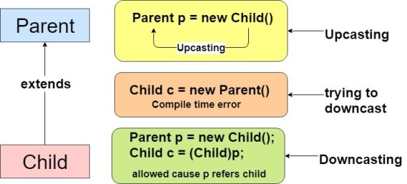
Up-casting & Down-casting
Typecasting is converting one data type to another.
Up-casting (Ex: Upcasting.java)
Converting a subclass type to a superclass type is known as up casting.
Down-casting (Ex: Downcasting.java)
Converting a superclass type to a subclass type is known as down casting.

Slide 21
Runtime Polymorphism
Runtime polymorphism or Dynamic Method Dispatch is a process in which a call to an overridden method is resolved at runtime rather than compile-time.
In this process, an overridden method is called through the reference variable of a superclass.
The determination of the method to be called is based on the object being referred to by the reference variable.
Example:
RuntimePolymorphism.java
Honda.java
BabyDog.java

Slide 22
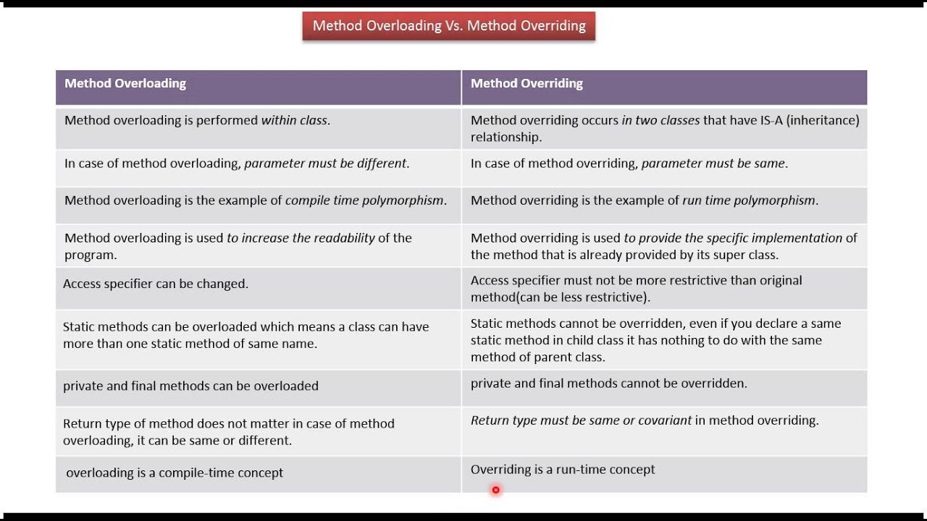
Runtime Polymorphism

Slide 23
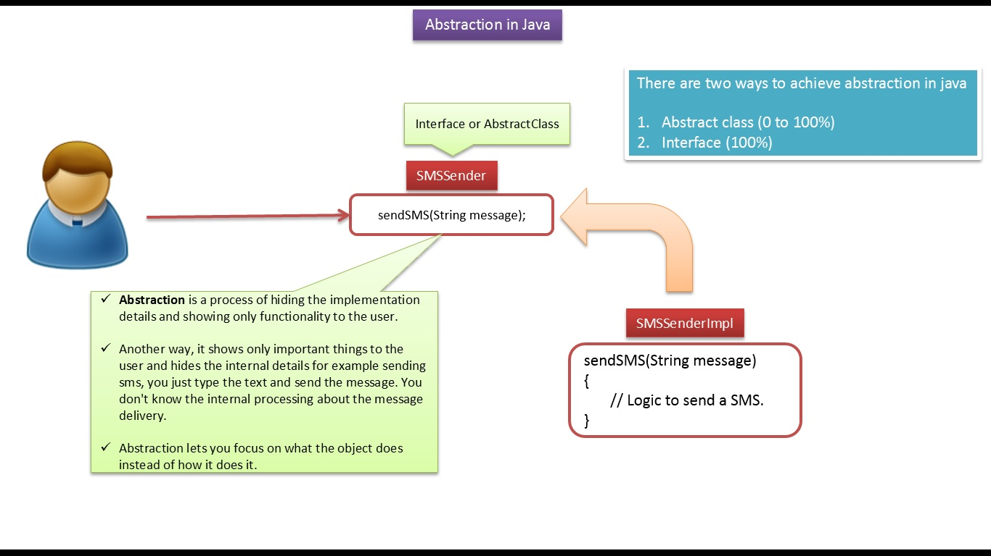
Abstract class
Abstraction
It is a process of hiding the implementation details and showing only functionality to the user.
It shows only essential things to the user and hides the internal details. For example, sending SMS where you type the text and send the message. You don't know the internal processing about the message delivery.

Slide 24
Abstract class
Abstract class
A class that is declared using “abstract” keyword is known as abstract class.
It can have abstract methods(methods without body) as well as concrete methods (regular methods with body).
A normal class(non-abstract class) cannot have abstract methods.
Why we need an abstract class?
Rules:
An abstract class must be declared with an abstract keyword.
It can have abstract and non-abstract methods.
It cannot be instantiated. (Why?)
It can have constructors and static methods also.
It can have final methods which will force the subclass not to change the body of the method.
It contain abstract methods that must be implemented later by any non abstract subclasses

Slide 25
Abstract class
Abstract method
Method that are declared without any body within an abstract class are called abstract method.
The method body will be defined by its subclass. Abstract method can never be final and static. Any class that extends an abstract class must implement all the abstract methods declared by the super class.
public abstract class Clothing{
private int id;
public int getId(){
return id;
}
public abstract double getPrice();
public abstract void display();
}
Concrete method
Abstract methods
Example: TestAbstraction1.java, TestAbstraction2.java, TestAbstraction3.java
Notes:
An abstract class cannot be instantiated. In fact, in many cases it would not make sense to instantiate them (Would you ever want to instantiate a Clothing?). However these classes can add a helpful layer of abstraction to a class hierarchy. The abstract class imposes a requirement on any subclasses to implement all of its abstract methods. Think of this as a contract between the abstract class and its subclasses.
The example above has a concrete method, getId. This method can be called from the subclass or can be overridden by the subclass.
It also contains two abstract methods: getPrice and display. Any subclasses of Clothing must implement these two methods.

Slide 26
Abstract class
When to use Abstract Methods & Abstract Class?
Abstract methods are usually declared where two or more subclasses are expected to do a similar thing in different ways through different implementations. These subclasses extend the same Abstract class and provide different implementations for the abstract methods.
Abstract classes are used to define generic types of behaviours at the top of an object-oriented programming class hierarchy, and use its subclasses to provide implementation details of the abstract class.

Slide 27
Interface
Interface
Abstract class which is used for achieving partial abstraction. Unlike abstract class an interface is used for full abstraction.
Interface looks like a class but it is not a class. An interface can have methods and variables just like the class but the methods declared in interface are by default abstract (only method signature, no body) and public.
Also, the variables declared in an interface are public, static & final by default. We will cover this in detail, later in this guide.
Interfaces can have default methods with implementation from java 8 onwards.
Default methods were introduced to provide backward compatibility for old interfaces so that they can have new methods without effecting existing code.
Interfaces can have static methods as well similar to static method of classes from java 8 onwards.

Slide 28
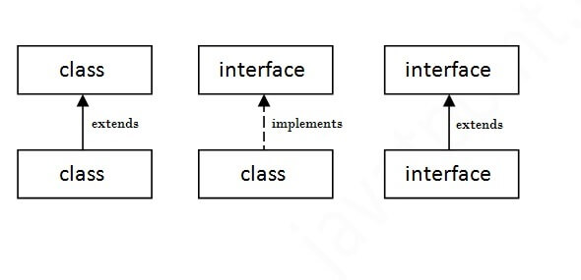
Interface
What is the use of interface in Java?
It is used to achieve abstraction. i.e. To achieve security - hide certain details and only show the important details of an object.
Java does not support "multiple inheritance“. However, it can be achieved with interfaces, because the class can implement multiple interfaces.
Syntax : interface interface_name { }
A class that implements an interface must implement all the methods declared in the interface.
Class and Interface Relation
A class extends another class, an interface extends another interface, but a class implements an interface.

Slide 29
Interface
Rules for using Interface
Methods inside Interface must not be final, native or strictfp
All variables declared inside interface are implicitly public, static and final variables(constants).
All methods declared inside Java Interfaces are implicitly public and abstract, even if you don't use public or abstract keyword.
Interface can extend one or more other interface.
Interface cannot implement a class.
Interface can be nested inside another interface.
An interface cannot contain a constructor (as it cannot be used to create objects)
Example: Interface1.java, Interface2.java, Interface3.java, Interface4.java

Slide 30
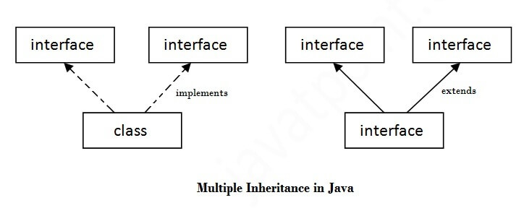
Multiple Inheritance by Interface
If a class implements multiple interfaces, or an interface extends multiple interfaces, it is known as multiple inheritance.
Multiple inheritance is not supported in the case of class because of ambiguity.
However, it is supported in case of an interface because there is no ambiguity. It is because its implementation is provided by the implementation class.
Example: MultipleInheritance1, 2, 3.java

Slide 31
Nested Interface
An interface i.e. declared within another interface or class is known as nested interface.
The nested interfaces are used to group related interfaces so that they can be easy to maintain.
The nested interface must be referred by the outer interface or class. It can't be accessed directly.
Example: NestedInterface1.java, NestedInterface2.java

Slide 32
Abstract class Vs. Interface
Abstract class | Interface
1) Abstract class can have abstract and non-abstract methods. | Interface can have only abstract methods. Since Java 8, it can have default and static methods also.
2) Abstract class doesn't support multiple inheritance. | Interface supports multiple inheritance.
3) Abstract class can have final, non-final, static and non-static variables. | Interface has only static and final variables.
4) Abstract class can provide the implementation of interface. | Interface can't provide the implementation of abstract class.

Slide 33
Abstract class Vs. Interface
5) The abstract keyword is used to declare abstract class. | The interface keyword is used to declare interface.
6) An abstract class can extend another Java class and implement multiple Java interfaces. | An interface can extend another Java interface only.
7) An abstract classcan be extended using keyword "extends". | An interface class can be implemented using keyword "implements".
8) A Javaabstract classcan have class members like private, protected, etc. | Members of a Java interface are public by default.
9)Example: public abstract class Shape{ public abstract void draw(); } | Example: public interface Drawable{ void draw(); }
Example: AbstractInterface.java

Slide 34
Extends vs. Implements
Extends is for extending a class and implements are for implementing an interface.
Example: ExtendImplement.java, ExtendImplement1.java
Can we use implements and extends at the same time?
Yes, you can but you need to write your extends before implements
Why “extends” precedes “implements” in class declaration?
Because the parent class must be compliable, it is easier if the compiler knows up front what that class is. Further, you can extend only one class but implement any number of interfaces.
The compilation time climbs if the extends keyword can be intermingled amongst any number of implements instructions. Compilers want to fail as fast as possible to decrease dev time, so this choice is logical.

Slide 35
Up-casting & Down-casting
Typecasting is converting one data type to another.
Up-casting (Ex: Upcasting.java)
Converting a subclass type to a superclass type is known as up casting.
Down-casting (Ex: Downcasting.java)
Converting a superclass type to a subclass type is known as down casting.

Slide 36
Up-casting & Down-casting
Assume the given class hierarchy
Mammal > Animal > Dog, Cat
Mammal- is the super interface
Animal- Abstract Class
Dog & Cat-Concrete class
public interface Mammal {
public void eat();
public void move();
public void sleep();
}
abstract class Animal implements Mammal {
public void eat() {
System.out.println("Eating...");
}
public void move() {
System.out.println("Moving...");
}
public void sleep() {
System.out.println("Sleeping...");
}
}
class Dog extends Animal {
public void bark() {
System.out.println("Gow gow!"); }
public void eat() {
System.out.println("Dog is eating..."); }
}
public class Cat extends Animal {
public void meow() {
System.out.println("Meow Meow!");
}
}

Slide 37
Up-casting & Down-casting
What is Up-casting?
Up-casting is casting a subtype to a super type, upward to the inheritance tree.
Example: Dog dog = new Dog();
Animal anim = (Animal) dog;
anim.eat();
Here, we cast the Dog type to the Animal type. Because Animal is the super type of Dog, this casting is called up-casting.
Note that the actual object type does not change because of casting. The Dog object is still a Dog object. Only the reference type gets changed.
This is also another example of up-casting:
Mammal mam = new Cat();
Animal anim = new Dog();
Up-casting is always safe and never fails.
Example: UpCast.java

Slide 38
Up-casting & Down-casting
Why is Up-casting?
Generally, up-casting is not necessary. However, we need up-casting when we want to write general code that deals with only the super type. Consider the following class:
class AnimalTrainer {
public void teach(Animal anim) {
anim.move();
anim.eat();
}
}
Here, the teach() method can accept any object which is subtype of Animal. So objects of type Dog and Cat will be up-casted to Animal when they are passed into this method.
Example: UpCast1.java
Dog dog = new Dog();
Cat cat = new Cat();
AnimalTrainer trainer = new AnimalTrainer();
trainer.teach(dog);
trainer.teach(cat);

Slide 39
Up-casting & Down-casting
What is Down-casting?
Down-casting is casting to a subtype, downward to the inheritance tree. For example:
Animal anim = new Cat();
Cat cat = (Cat) anim;
Here, cast the Animal type to the Cat type. As Cat is subclass of Animal, this casting is called down-casting.
Unlike up-casting, down-casting can fail if the actual object type is not the target object type. For example:
Animal anim = new Cat();
Dog dog = (Dog) anim;
This will throw a ClassCastException because the actual object type is Cat. And a Cat is not a Dog so we cannot cast it to a Dog.
The Java language provides the instanceof operator to check type of an object before casting.

Slide 40
Up-casting & Down-casting
The java instanceof operator is used to test whether the object is an instance of the specified type (class or subclass or interface).
The instanceof in java is also known as type comparison operator because it compares the instance with type. It returns either true or false. If we apply the instanceof operator with any variable that has null value, it returns false.
if (anim instanceof Cat) {
Cat cat = (Cat) anim;
cat.meow();
} else if (anim instanceof Dog) {
Dog dog = (Dog) anim;
dog.bark();
}
Example: DownCast.java

Slide 41
Up-casting & Down-casting
Why is Down-casting?
Down-casting is used more frequently than up-casting. Use down-casting when we want to access specific behaviours of a subtype. For Example:
class AnimalTrainer {
public void teach(Animal anim) {
// do animal-things
anim.move();
anim.eat();
// if there's a dog, tell it barks
if (anim instanceof Dog) {
Dog dog = (Dog) anim;
dog.bark();
}
}
}
Example: DownCast1.java
Here, in the teach() method, we check if there is an instance of a Dog object passed in, downcast it to the Dog type and invoke its specific method, bark().

Slide 42
Variable Arguments (Varargs)
Varargs is a short name for variable arguments. In Java, an argument of a method can accept arbitrary number of values. This argument that can accept variable number of values is called varargs.
Syntax :
accessModifier methodName(datatype… arg) { // method body }
In order to define vararg, ... (three dots) is used in the formal parameter of a method.
The ... syntax tells the Java compiler that the method can be called with zero or more arguments.
Note:
A method can have variable length parameters with other parameters too, but one should ensure that there exists only one varargs parameter that should be written last in the parameter list of the method declaration.
Vararg Methods can also be overloaded but overloading may lead to ambiguity. Ex: VarargExample.java, VarargOverload.java

Slide 43
Static Keyword
To create a static member(block, variable, method, nested class), precede its declaration with the keyword static. When a member is declared static, it can be accessed before any objects of its class are created, and without reference to any object.
The static keyword in Java is used for memory management mainly. It belongs to the class than an instance of the class.
Static Block
Static block is used for initializing the static variables. This block gets executed when the class is loaded in the memory. A class can have multiple Static blocks, which will execute in the same sequence in which they have been written into the program. Example: StaticBlock.java
Static Variables
A static variable is common to all the instances (or objects) of the class because it is a class level variable. In other words you can say that only a single copy of static variable is created and shared among all the instances of the class. Memory allocation for such variables only happens once when the class is loaded in the memory. Example: StaticVariable1.java, StaticVariable2.java

Slide 44
Static Keyword
Java Static Methods
Static Methods can access class variables(static variables) without using object(instance) of the class, however non-static methods and non-static variables can only be accessed using objects.
Restrictions:
They can only call other static methods
They can only access static data
They cannot refer to this or super in any way.
Example: StaticMethod.java
Static Class
A class can be made static only if it is a nested class.
Nested static class doesn’t need reference of Outer class
A static class cannot access non-static members of the Outer class

Slide 45
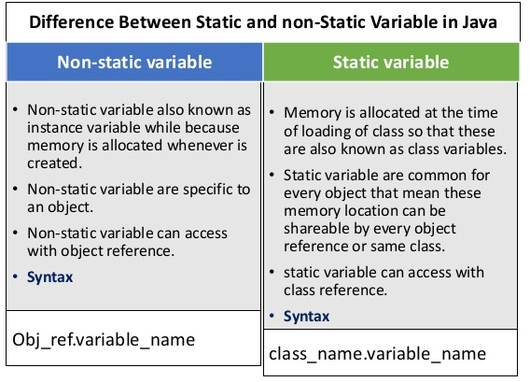
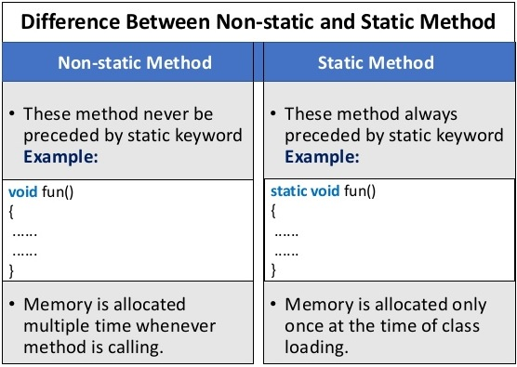
Static Vs Non-static

Slide 46
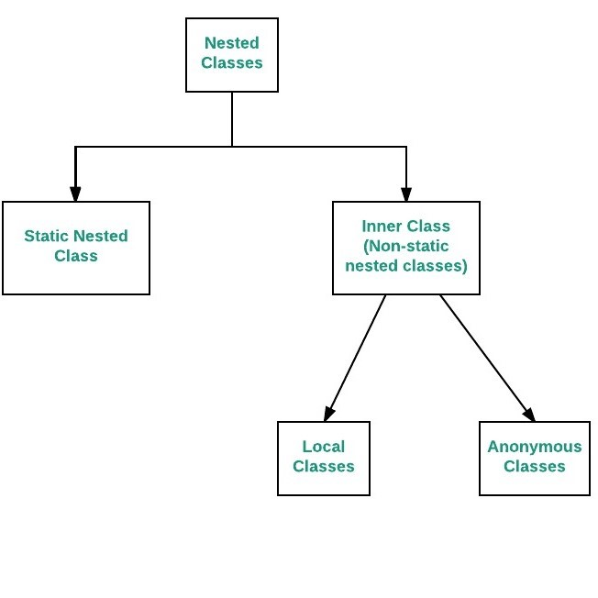
Nested Classes
To define a class within another class, such classes are known as nested classes. They enable you to logically group classes that are only used in one place, thus this increases the use of encapsulation, and create more readable and maintainable code.
The scope of a nested class is bounded by the scope of its enclosing class.
A nested class has access to the members, including private members, of the class in which it is nested. However, reverse is not true i.e. the enclosing class does not have access to the members of the nested class.
A nested class is also a member of its enclosing class.
Syntax:
class OuterClass
{ ...
class NestedClass
{ ...
}
}

Slide 47
Nested Classes
To instantiate an inner class, you must first instantiate the outer class.
Then, create the inner object within the outer object with this syntax: - OuterClass.InnerClass innerObject = outerObject.new InnerClass();
Example: NestedClassDemo.java
Static Nested Class
A static class i.e. created inside a class is called static nested class in java. It cannot access non-static data members and methods. It can be accessed by outer class name.
It can access static data members of outer class including private.
Static nested class cannot access non-static (instance) data member or method.
For example, to create an object for the static nested class, use this syntax:
OuterClass.StaticNestedClass nestedObject = new OuterClass.StaticNestedClass();
Example: StaticNestedClassDemo.java

Slide 48
Inner Class: Local Classes
A local inner class can be declared within a block. This block can be either a method body, initialization block, for loop or even an if statement.
Accessing Members:
A local inner class has access to fields of the class enclosing it as well as the fields of the block that it is defined within.
These classes, however, can access the variables or parameters of the block that encloses it only if they are declared as final or are effectively final.
A variable whose value is not changed once initialized is called as effectively final variable.
A local inner class defined inside a method body, have access to it’s parameters.
Example: LocalClass.java

Slide 49
Anonymous inner class
A class that have no name is known as anonymous inner class in java. It should be used if you have to override method of class or interface. Java Anonymous inner class can be created by two ways:
Class (may be abstract or concrete).
Interface
Define a class in place instead of in a separate file
Why would you do this?
Logically group code in one place
Increase Encapsulation
Make code more readable
Anonymous inner classes are useful in writing implementation classes for listener interfaces in graphics programming.

Slide 50
Anonymous inner class
Note:
A class is created but its name is decided by the compiler which extends the Person class and provides the implementation of the eat() method.
An object of Anonymous class is created that is referred by p reference variable of Person type.
Example: TestAnonymousInner.java, TestAnonymousInner1.java, TestAnonymousInner2.java, TestAnnonymousInner3.java

Slide 51
abstract class Person{
abstract void eat();
}
class TestAnonymousInner{
public static void main(String args[]){
Person p=new Person(){
void eat(){
System.out.println("nice fruits");
}
};
p.eat();
}
}
Internal class generated by the compiler
import java.io.*;
static class TestAnonymousInner$1 extends Person
{
TestAnonymousInner$1(){}
void eat()
{
System.out.println("nice fruits");
}
}

Slide 52
Lambda Expressions
Lambda expression is a new and important feature of Java which was included in Java SE 8.
It provides a clear and concise way to represent one method interface using an expression.
Lambda expressions basically express instances of functional interfaces.
An interface which has only one abstract method is called functional interface.
Lambda expressions implement the only abstract function and therefore implement functional interfaces
Why?
To provide the implementation of Functional interface.
Less coding.
It facilitates functional programming, and simplifies the development a lot.
It is very useful in collection library. It helps to iterate, filter and extract data from collection.

Slide 53
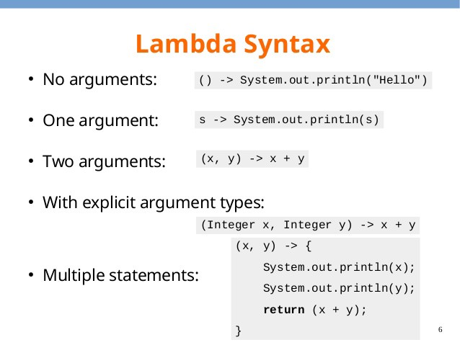
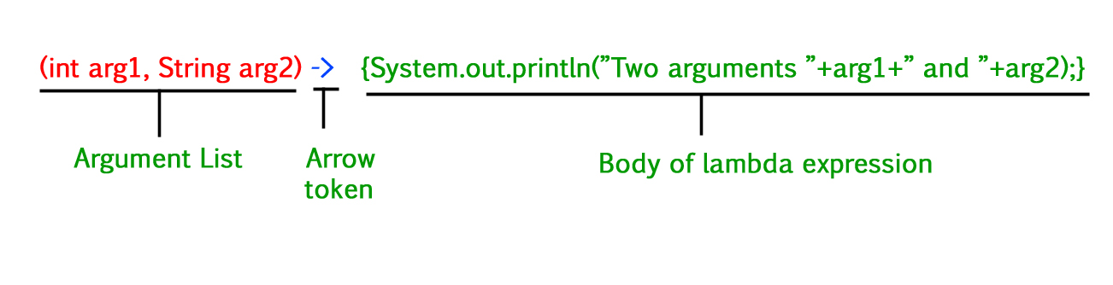
Example: LambdaExpressionExample1,2,3,4,5,6.java

